Slide 1
HTI-XC900
Dual-eyes 4K camera
-Product over view
-Product highlight
- Product comparison
- Product application
Product release

Slide 2
PRODUCT overview
,
Product highlight： Dual eyes, one 4K PTZ tracking lens, and one HD panoramic lens 2. Support multiple intelligent recognition and tracking technologies, including facial tracking, portrait tracking, and voice tracking 3. Rotate the pan tilt at a large angle, with a large number of preset positions 4. Support network control, serial protocol control (RS232), and infrared remote control 5. Multiple USB and HDMI modes for 4k output 6. Compatible with conference platform like Teams，Zoom，Webex，google meeting, etc.

Slide 3
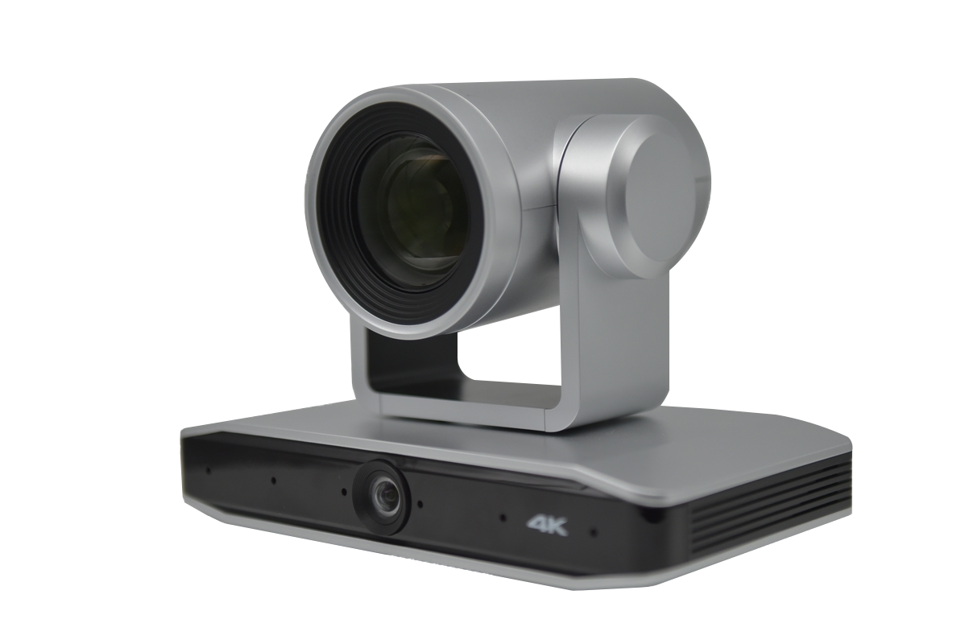
Product highlight
,
New PTZ and dual-eyes camera hardware design
-- capture the best picture of participants
8.51MP high-quality SONY CMOS, support 4k@30fps video
Dual-lens camera, tracking lens + panoramic lens
Not only provides two screen options, but it also ensures more accurate voice + image positioning,
PTZ ability to cover large room
±110° pan, ±30°Tilt, 12 optical*15 digital zoom

Slide 4
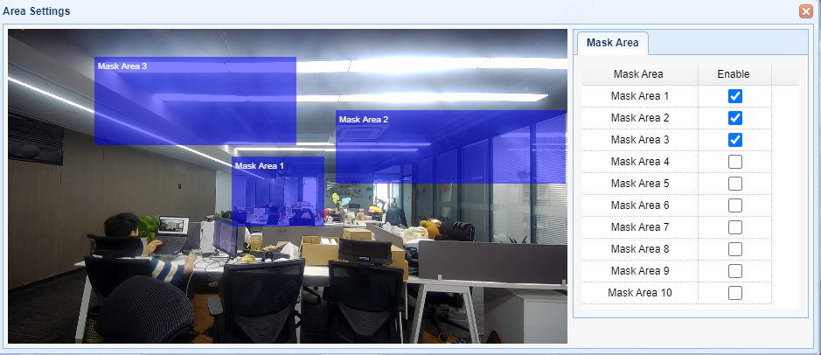
Product highlight
,
Advanced voice tracking software function
--Design the tracking mode by your own
Adjustable voice detection time up to 0.5s, which works with tracking sensitivity mode can help user to find solution for different conference requirement
Customized close-up holding time from 1-3 seconds,
Whether you are an active performer or a standing lecturer, XC900 can maintain the capture of you
Panorama mode and time setting designed for conference manager, camera will automatically return to full view when people stop talking within your limited time frame
Support 10 voice tracking mask area, you can simply draw a box in the screen of full-view camera to complete the settings, which helps to avoid the area you don’t want to be track

Slide 5
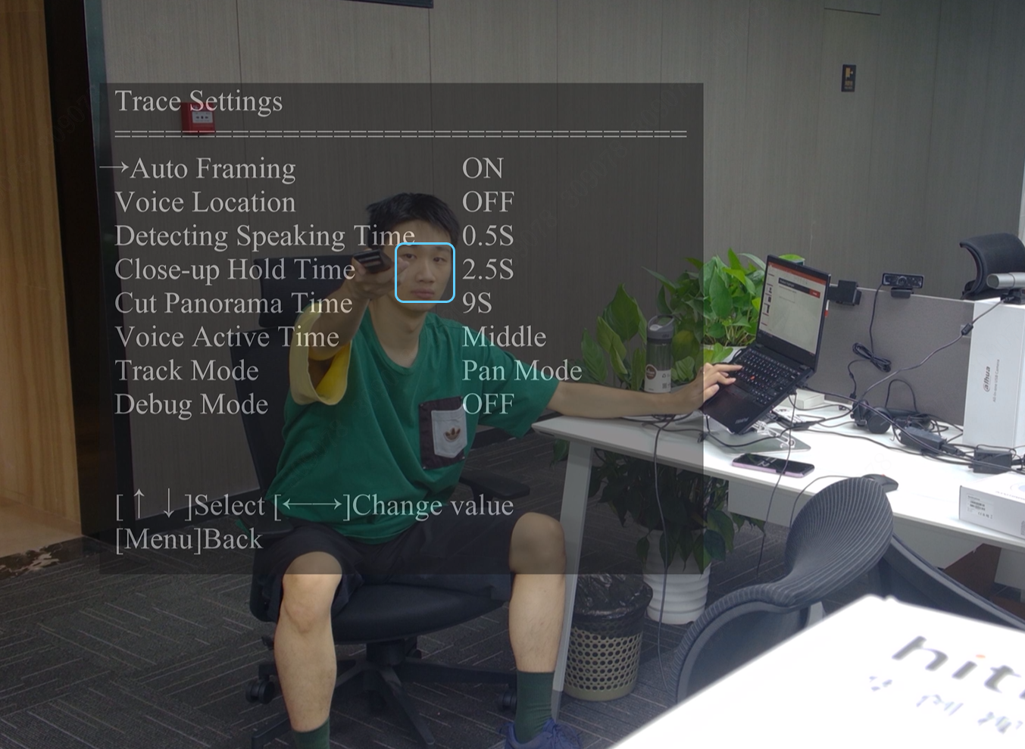
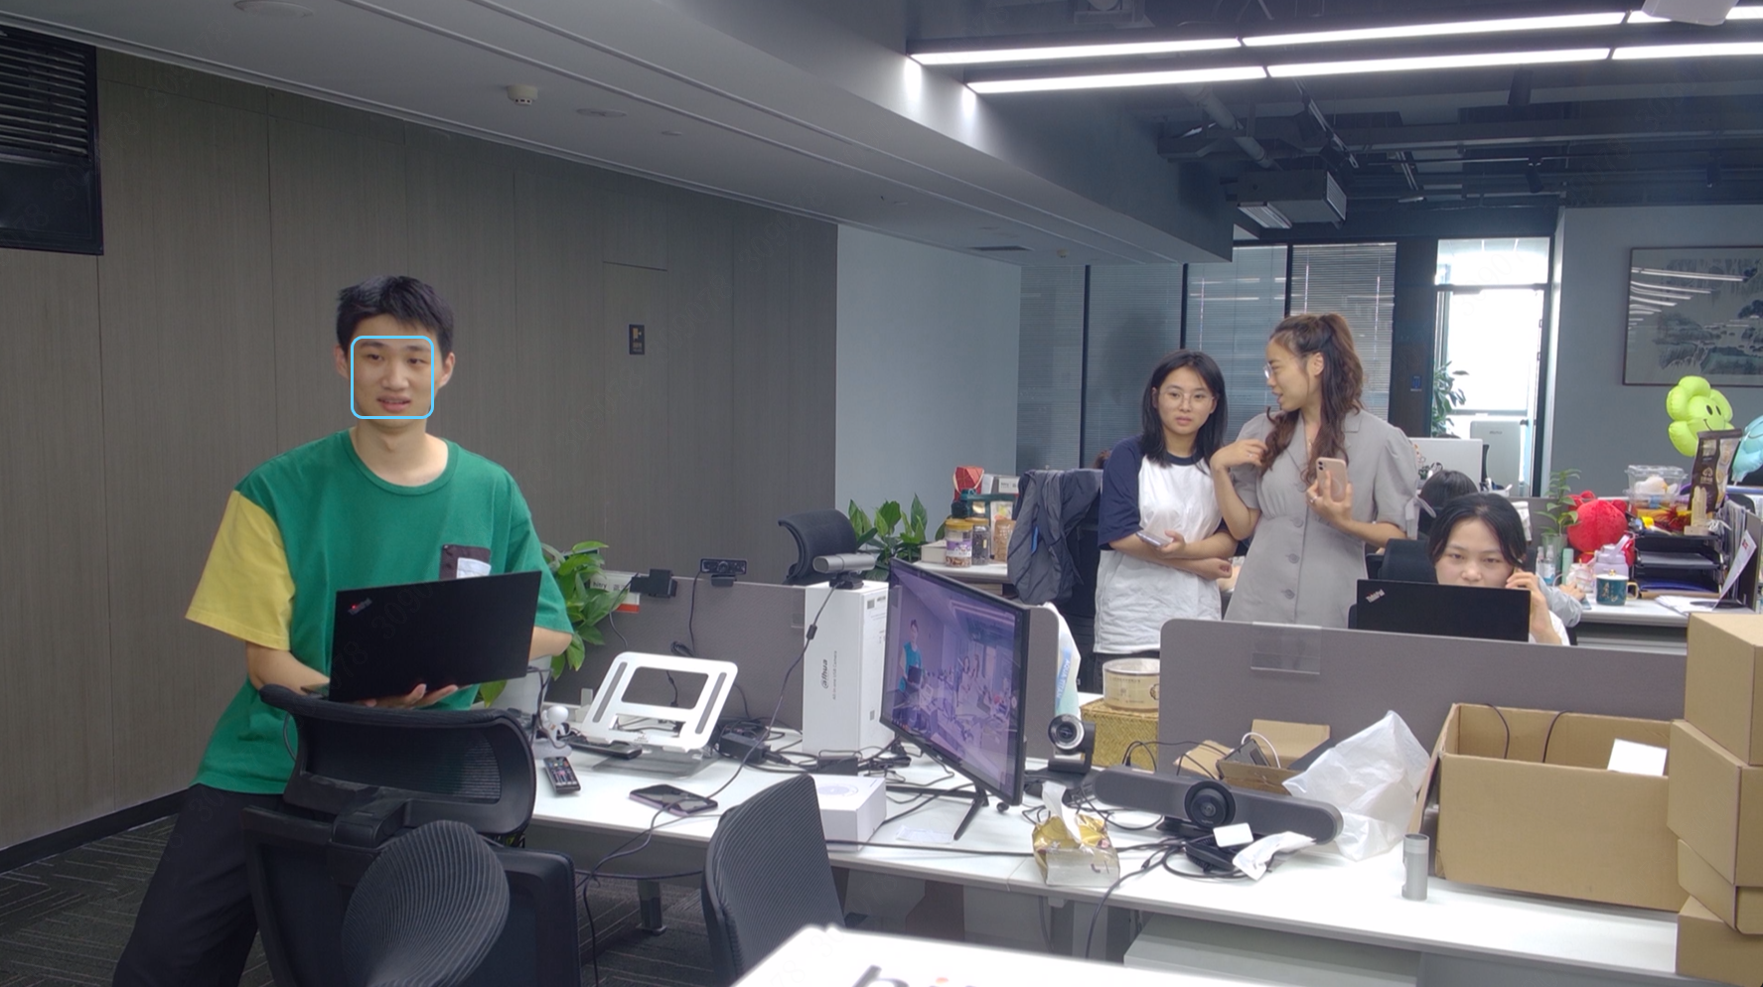
Product highlight
,
Multiple human face recognition application
Auto framing for multi-participants meeting, using human image recognition and location data from full-view camera to catch all participants in the picture at the middle from video
Speaker tracking, using human face to focus on speakers on the podium, eliminating interference caused by voice tracking, more stable and smooth tracking experience

Slide 6
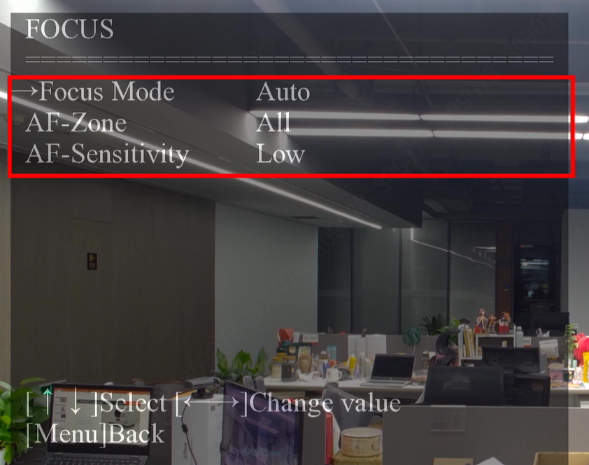
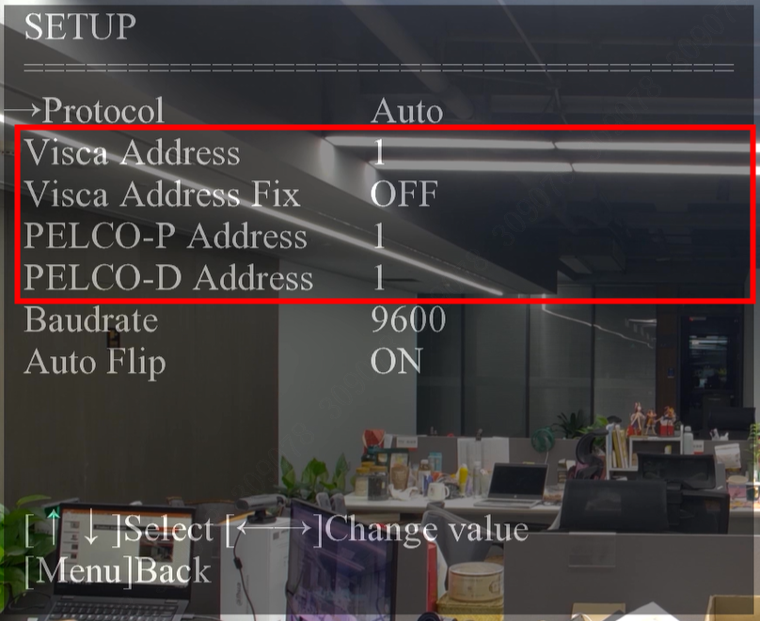
Product highlight
,
Fast, flexible, and comprehensive screen selection under simple control
Support for customize focus mode, area, and speed.
Support 254 presets controlled on website or 10 presets on remote controller; one click wake up within 1 sec. suitable for performance.
Supports multiple control protocols: VISCA standard camera control protocol
PELCO-D/P, supporting integration with video matrix system
Support the adjustment of multiple Baud, taking into account the data transmission rate and accuracy

Slide 7
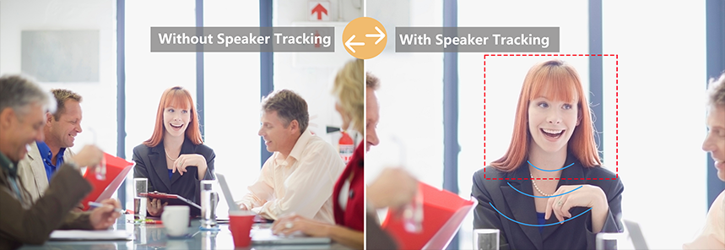
Product application
,
For enterprise
Large-middle room conference--single speaker--focus on the speaker and combine with automatic voice activated switching on meeting software to provide a more focused remote meeting----improve meeting efficiency—create more value for enterprise
Large-middle room conference-- Multi person discussion, keep all participants in the picture or select the main speaker to tracking, everyone feel strong sense of participation—better working experience -- higher employee satisfaction--more reasonable talent exploration and retention

Slide 8
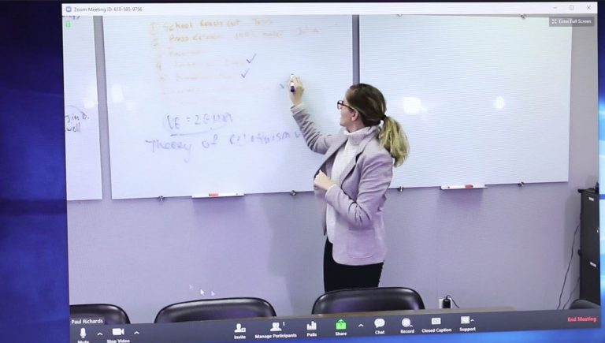
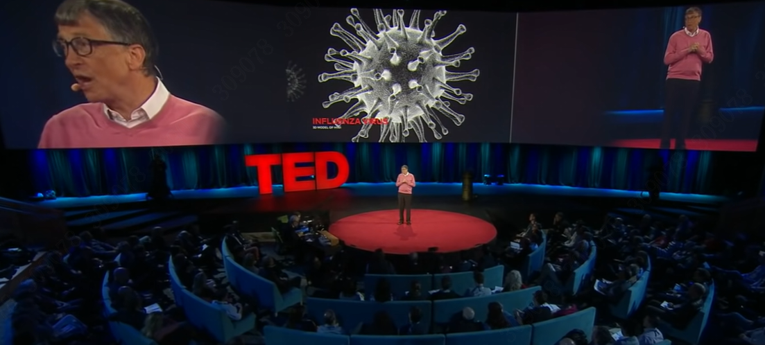
Product application
,
For education
Hybrid teaching---- teacher tracking----lecture recording----expand lecture value----create more profit for university and school
Lecture live stream----emphasize lecturer and avoiding environmental interference----ideal experience for lecturer and audience----A more popular speech space----Wider knowledge dissemination and greater benefits

Slide 9
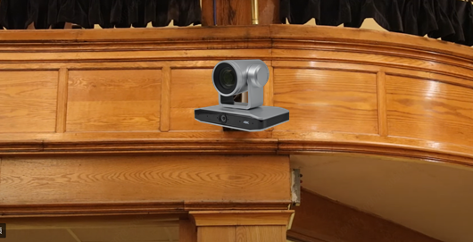
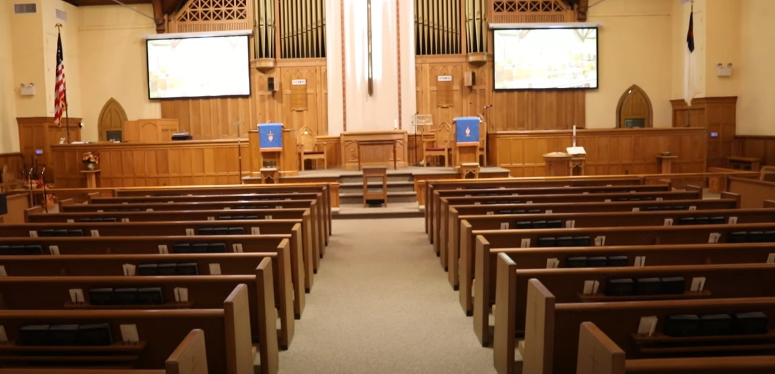
Product application
,
For Church
Church services live-streaming
----allows churches to reach a larger audience and connect with those who are unable to attend service in person
----ease control for camera view, high quality image
----The most realistic picture broadcast
----Better Church service, better reputation, better religious spreading

